Slide 1

Microsoft365DSC in Action
@NikCharlebois
Senior Program Manager – Graph Team
Microsoft

Slide 2








MICROSOFT 365 VIRTUAL MARATHON 2021 SPONSORS

Slide 3



Nik Charlebois
Senior Program Manager – Microsoft Graph Team
Ex-MVP, Author, Blogger, Speaker
Gatineau, Quebec
Principal Lead – Microsoft365DSC
https://NikCharlebois.com

Slide 4

AGENDA
Overview of Microsoft365DSC
What’s New
What’s Coming
Q&A

Slide 5
Overview

Slide 6

What is Microsoft365DSC?
@NikCharlebois

Slide 7


Automate
Report
Export
Monitor
Synchronize
Assess
@NikCharlebois

Slide 8

Community
100% Open-Source on GitHub;
All the documentation is on the website;
Worldwide team of dedicated engineers and community contributors;
aka.ms/M365DSC
@NikCharlebois

Slide 9

Installation
Latest source code on GitHub;
Releases on the PowerShell Gallery;
Install the module with all sub-dependencies with a single call:
Install-Module Microsoft365DSC -AllowClobber
@NikCharlebois

Slide 10
Automate
@NikCharlebois

Slide 11
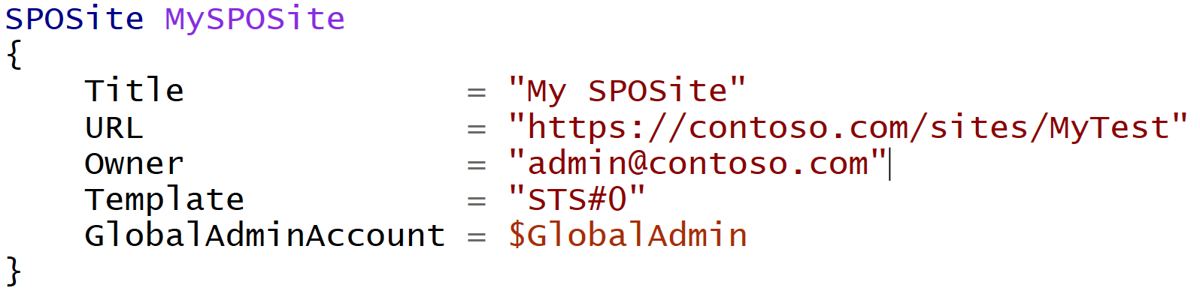
Difference with Classic PowerShell
It’s a Declarative approach;
@NikCharlebois
Notes:
Meaning I don’t tell it do this and then that, but rather here is how I want this, then do whatever in you need to to get me there

Slide 12
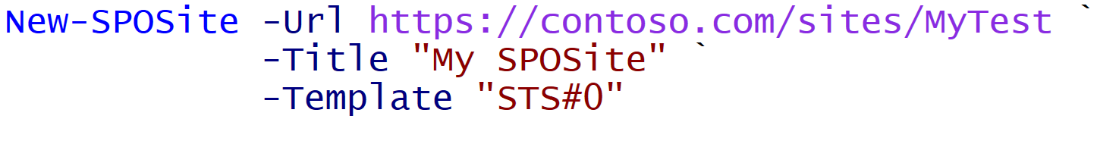
Difference with Classic PowerShell
Declarative:
Imperative:
@NikCharlebois
Notes:
Meaning I don’t tell it do this and then that, but rather here is how I want this, then do whatever you need to get me there

Slide 13

Automate – Deploy Configuration
Write your Microsoft 365 Configuration as Code
@NikCharlebois

Slide 14








Automate – Deploy Configuration
Automate the Configuration of all M365 Workloads
@NikCharlebois

Slide 15

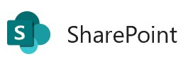



Logic Flow
Abstraction layer sitting on top of all underlying modules;
Allows you to write 1 configuration to handle all workloads;
Microsoft365DSC Configuration
SharePoint PnP
MicrosoftTeams
SkypeForBusinessAPI
Exchange Online Shell
…
Remote Calls
Security & Compliance
@NikCharlebois

Slide 16
Monitor
@NikCharlebois

Slide 17


Monitor – Continuously check for config drifts
Analyze for Drift
Act on detected drifts: Fix, Log or Alert
@NikCharlebois

Slide 18
Monitor Configuration Drifts
+Fix
+Monitor
Default Setting
ApplyOnly
ApplyAndMonitor
ApplyAndAutocorrect
Configure as specified, the done
Configure, and Log Configuration Drifts
Configure, Log & Fix Configuration Drifts
@NikCharlebois

Slide 19
Export
@NikCharlebois

Slide 20
Export – Get full fidelity config from existing tenant
Export
Full-Fidelity Configuration Export
Existing Microsoft 365 Environments
@NikCharlebois

Slide 21

Exposes the Export-M365DSCConfiguration cmdlet when M365DSC is installed;
Provides an interface to pick and choose components to extract;
Exports all configuration as a .ps1 configuration file;
Simply need to provide credentials of account with admin access to the selected workloads
@NikCharlebois

Slide 22
Report
@NikCharlebois

Slide 23


Report – Convert config to Excel or HTML
Export
Generate Reports
@NikCharlebois

Slide 24
Synchronize
@NikCharlebois

Slide 25
Synchronize – Keep multiple tenants’ config in Sync
Tenant A
Export
Automate
Tenant B
@NikCharlebois

Slide 26
Synchronize – Keep multiple tenants’ config in Sync
Tenant A
Tenant B
@NikCharlebois

Slide 27
Assess
@NikCharlebois

Slide 28

Assess – Blueprints
Assess Existing Environments Against Known Good Configurations
M365DSC Blueprints
Discrepancy Report
@NikCharlebois

Slide 29

Assess – Different Tenants
Tenant A
Tenant B
Discrepancy Report
Export
Export
Generate
Compare
@NikCharlebois

Slide 30
Assess – Delta between 2 Point-in-Time Exports
April 2020
Export
April 2020
@NikCharlebois

Slide 31
Assess – Delta between 2 Point-in-Time Exports
May 2020
Export
April 2020
May 2020
@NikCharlebois

Slide 32
Assess – Delta between 2 Point-in-Time Exports
Discrepancy Report
Generate
April 2020
May 2020
Compare
@NikCharlebois

Slide 33
Demo
Overview of Microsoft365DSC
@NikCharlebois

Slide 34
What’s New

Slide 35

New Dependency on DSCParser – May 2020
Added DSC Parser as a dependencies of the project;
DSCParser is also an Open-Source project managed by our team;
Helps improve and speed up drifts comparisons;
Can be used to parse and query exported configuration;
Opens the door to several new business scenarios for you to uncover and imagine;

Slide 36

Support for Planner – June 2020
Supports Plans, Buckets & Tasks
Leveraging the Microsoft Graph under the cover;
Requires Delegated Permissions
Submitted as part of an active engagement;
Not recommended for monitoring;

Slide 37

DevOPS Whitepaper – July 2020
Provide step-by-step guidance on how to integrate M365DSC to DevOPS projects;
Hosted in the Resources section of the Microsoft365DSC.com website;
Live document being refreshed on a regular basis;
Working on adding steps for GitHub;

Slide 38
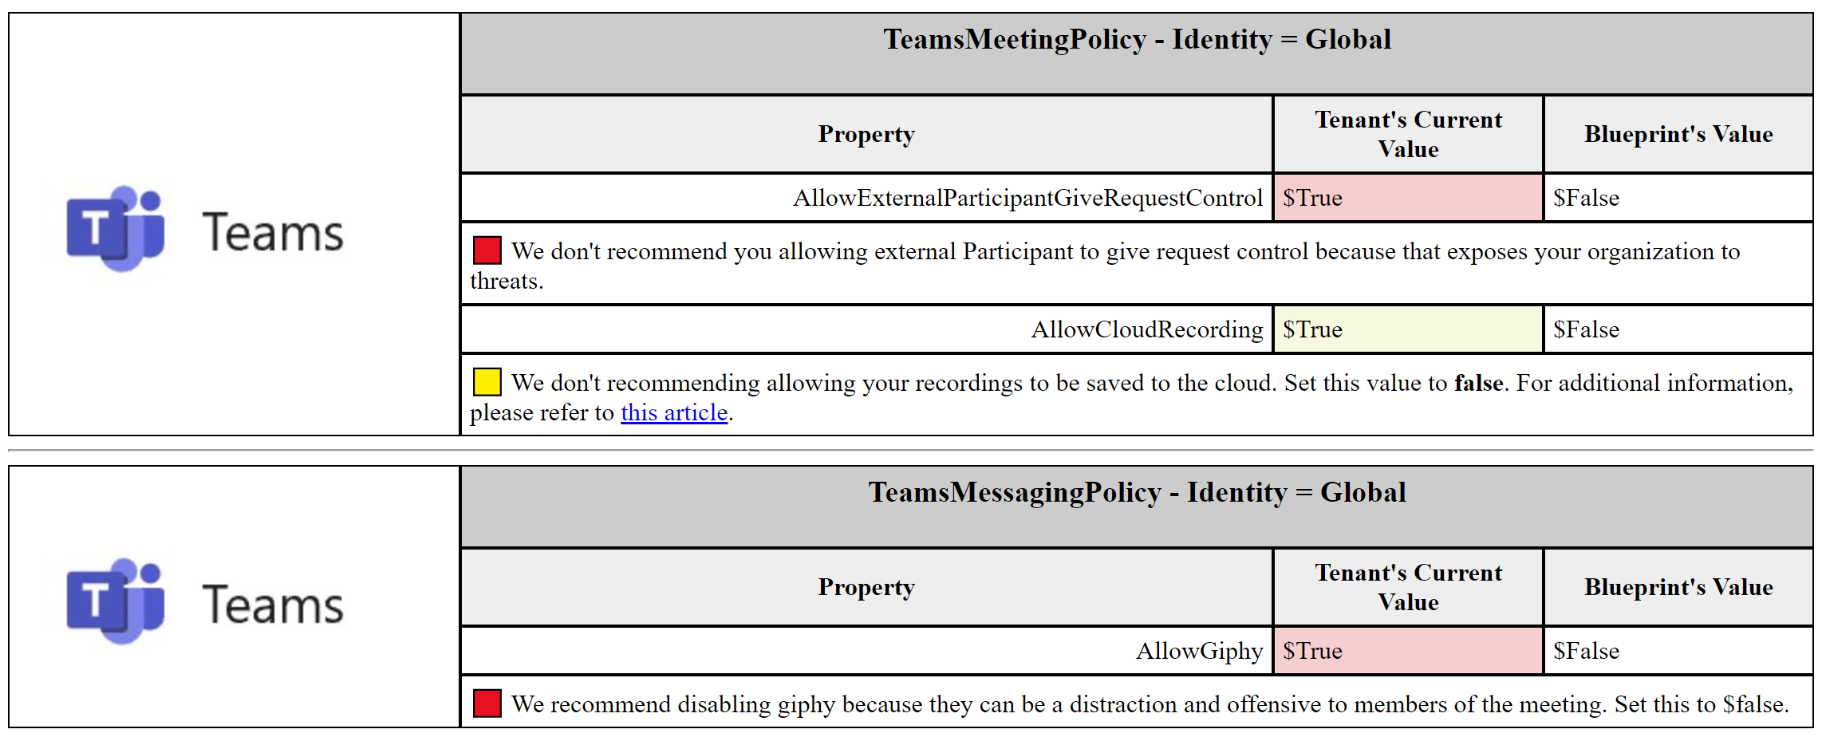
Advanced Blueprints – August 2020
Ability to assign severity level to discrepancies;
Ability to add custom messages and links to documentation;
Support for custom HTML Heading;

Slide 39

Support for Intune – November 2020
Leveraging the Microsoft Graph under the cover;
New community lead appointed in April 2021 to accelerate development;
Looking for feedback from the community on priority list;

Slide 40
What’s Coming

Slide 41
New Web Based Graphical User Interface (GUI)
Decoupled from the main Microsoft365DSC project.
Cleaner and more intuitive interface;
Ability to install as an electron app;
Will not trigger the export; instead will build the command to execute;
Up to the user to copy and execute the resulting command.
Coming in June 2021

Slide 42

Revamp of Resources to Leverage the Graph PowerShell SDK
Very early in the planning cycle;
Advantage is to reduce number of dependencies and support PowerShell Core;
May have an impact on authentication mechanisms;
Will most certainly require breaking changes;
Plan is to have first round of revamp released in first release of October 2021;

Slide 43
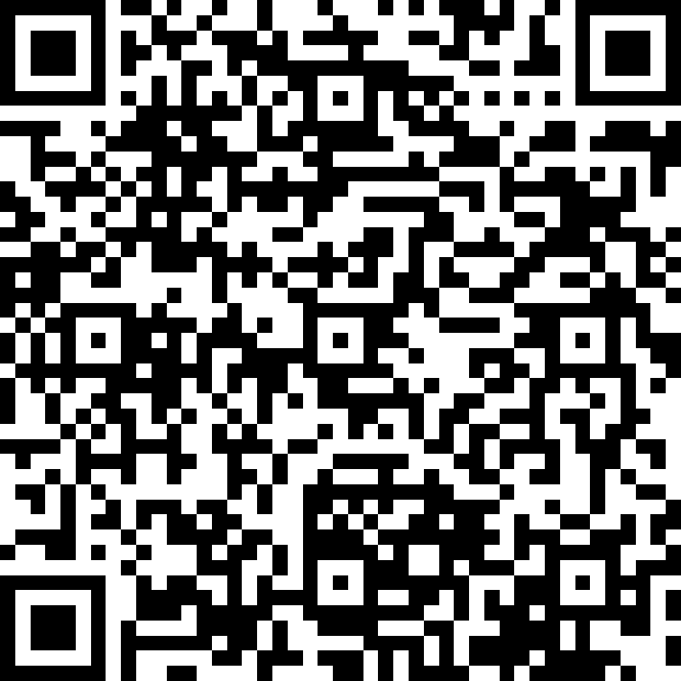
SPEAKER AND EVENT FEEDBACK
http://bit.ly/M365VM21Feedback

Slide 44
Q&A

